Slide 1
ARTIFICIAL INTELLIGENCE REPORT
AI IN BIOTECHNOLOGY

Slide 2
Introduction
Biotechnology is technology that utilizes biological systems, living organisms or parts of this to develop or create different products.
Today, the five branches into which modern biotechnology is divided — human, environmental, industrial, animal and plant — help us fight hunger and disease, produce more safely, cleanly and efficiently, reduce our ecological footprint and save energy

Slide 3
Types of AI in biotechnoligy
AI in Agricultural biotechnology
AI in Medical biotechnology
AI in Animal biotechnology
AI in Industrial biotechnology
AI in Bioinformatics
AI in forest biotechnology

Slide 4
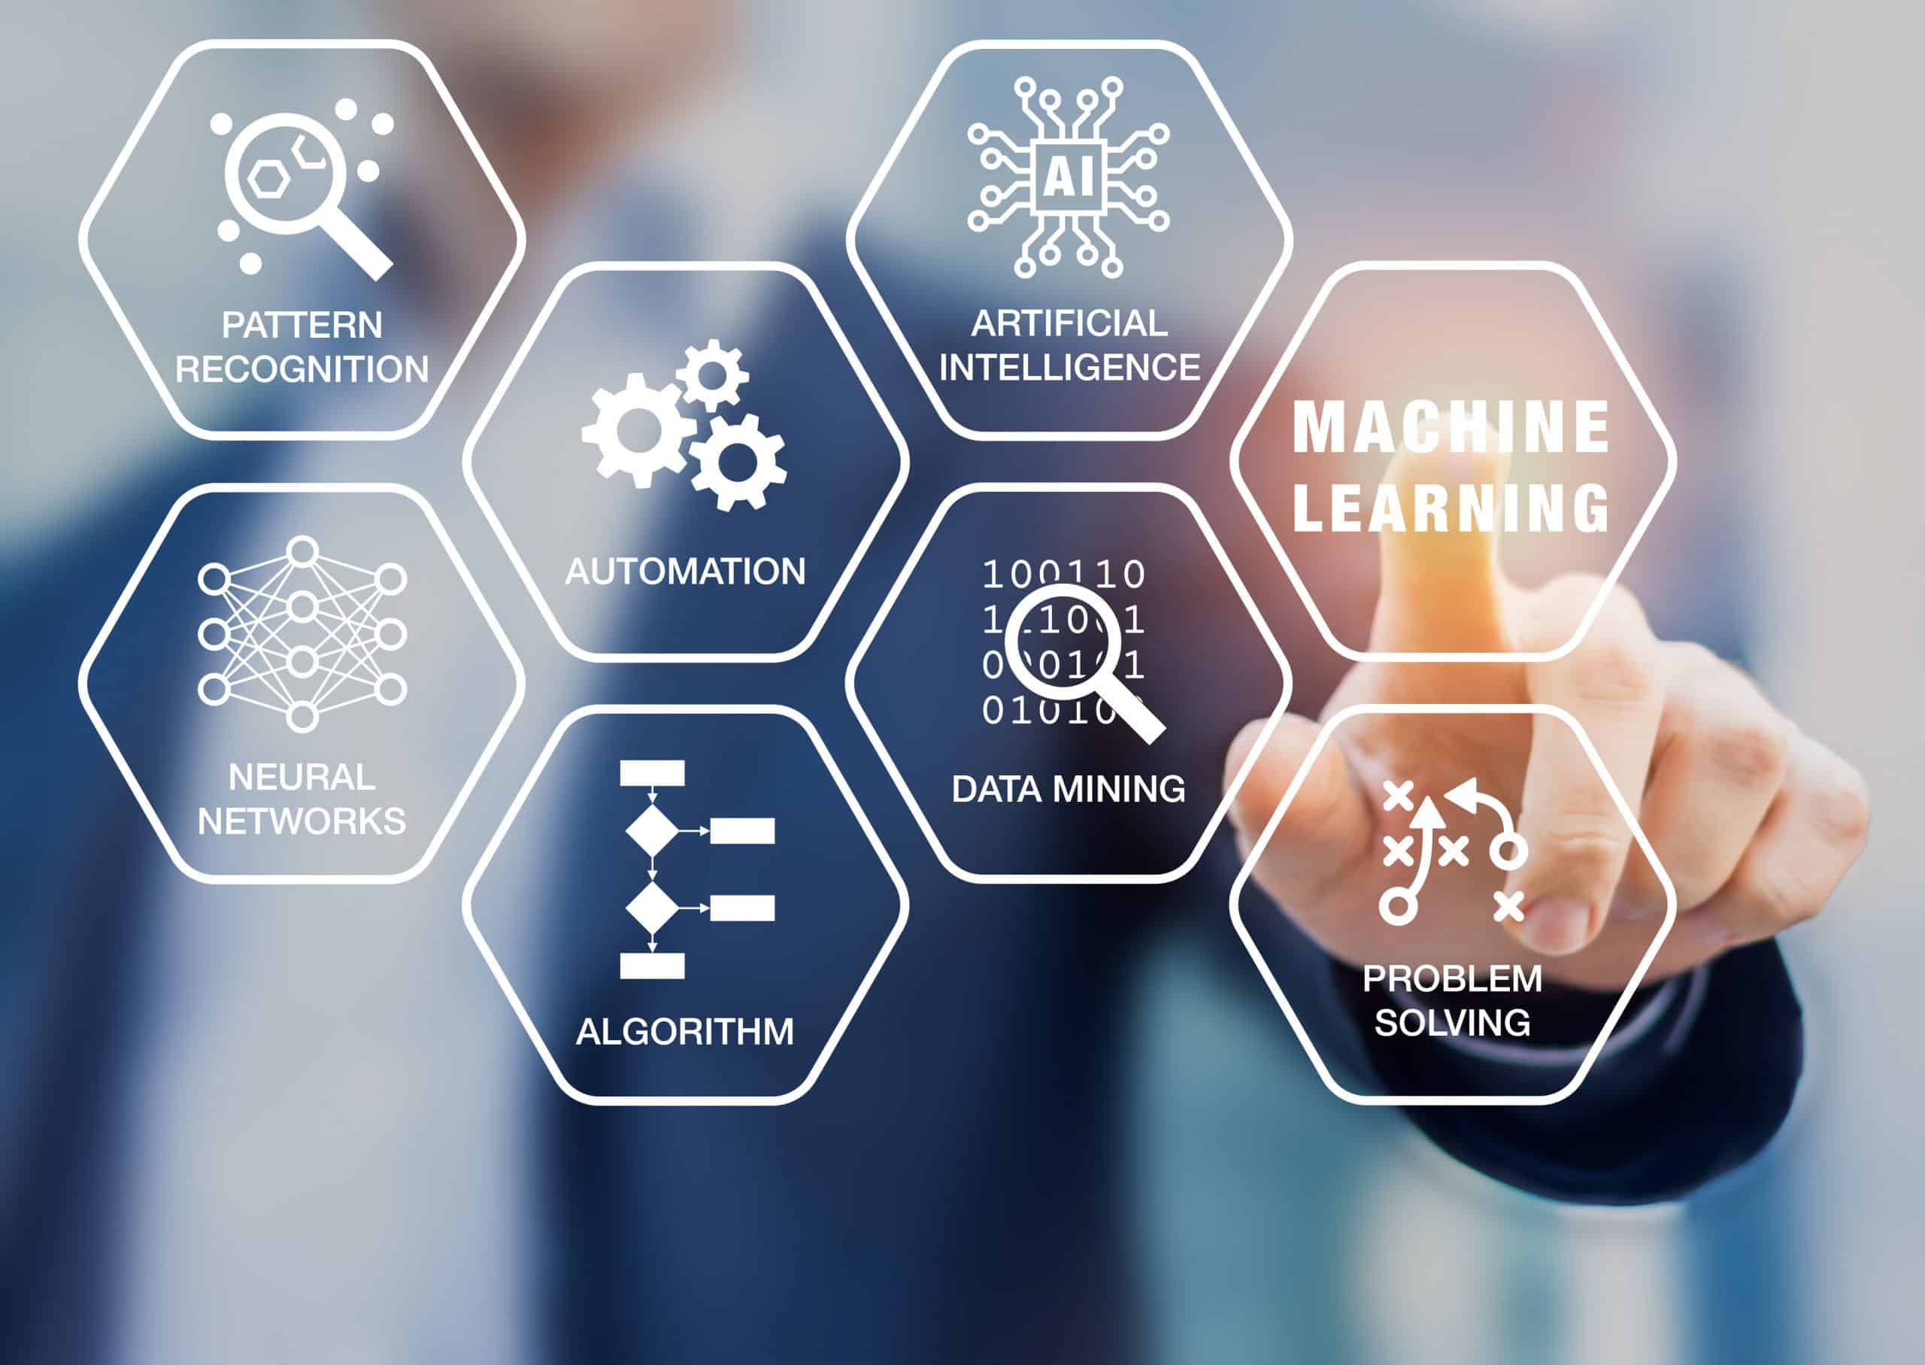

Slide 5
AI in Agricultural biotechnology
Agricultural biotechnology develops genetically modified plants to increase crop yields or introduce new characteristics to the existing plants. It involves conventional plant breeding, tissue culture, micro propagation, molecular breeding, and genetic engineering of plants.
Biotechnology firms are now leveraging Artificial Intelligence and Machine Learning techniques to develop and program autonomous robots that handle important agricultural tasks like harvesting crops at a much faster pace than humans. Computer Vision and Deep Learning algorithms are leveraged to process and analyze the data captured by drones. This helps in monitoring crop and soil health. Machine Learning algorithms help in tracking and predicting various environmental changes like the weather changes that impact the crop yield.

Slide 6
AI in Medical biotechnology
Medical biotechnology uses living cells for the betterment of human health by producing drugs and antibiotics. It also involves the study of DNA and genetically manipulates the cells to increase the production of important and beneficial characteristics.
Artificial Intelligence and Machine Learning are extensively used in drug discovery. Machine Learning helps in discovering small molecules that could give therapeutic benefits dependent on known target structures. Machine Learning is widely used in diagnosing diseases as it uses the true result to improve the diagnostic tests i.e., the more diagnostic tests that are run, the more accurate results can be achieved. AI is also helping in reducing the radiation therapy planning process resulting in saving time and improving patient care.

Slide 7
AI in Animal biotechnology
This branch applies molecular biology techniques to genetically engineer /modify the animals to improve their sustainability for pharmaceutical, industrial, or agricultural purposes.
The breeding of animals is one area where Artificial Intelligence and machine learning models provide valuable insights. Selective breeding is a very common practice where animals with the most desirable characteristics are bred with each other so that their offspring will also result in the same traits. This practice is implemented on the molecular level too where genetic characteristics among the animals are selected and such animals are bred. Machine learning is being used to interpret large genomic data sets and annotate a wide variety of genomic sequence elements.

Slide 8
AI in Industrial biotechnology
Industrial biotechnology is all about biopolymers substitutes, the invention in various areas like vehicle parts, fuels, fibers, new chemicals, and the production process.
Internet of Things (IoT), Machine Learning, and Artificial Intelligence analyze the machines, predict outages, optimize equipment, etc to provide efficient production and better product quality. Computer-aided designs and Artificial Intelligence are coming up with the desired molecule design. Robotics and Machine Learning cultivate the strains and test to what extent the desired molecule was reached.

Slide 9
AI in Bioinformatics
Bioinformatics helps the acquisition, storage, processing, distribution, analysis, and interpretation of biochemical and biological information with the help of mathematical, computer science, and biology tools to understand the biological significance of a variety of data. This information is organized in large data pools.
This information needs to be harnessed to gain tremendous insights. Artificial Intelligence and Machine Learning are leveraged in DNA sequencing from the huge data crunch involved, classification of protein along with protein’s catalytic role and biological function, analysis of gene expressions, genome annotation where a certain level of automation is required to identify the locations of genes, computer-aided drug design, etc.

Slide 10
AI in forest biotechnology
Wood is an increasingly important resource for humanity and natural forests are of enormous ecological value. However, these slow-growing forests are unable to meet current demand, resulting in loss and degradation of forest resources. This is where forest biotechnology, especially genetic engineering, can help. This is very important because plantation forests, for example, are urgently needed to sustainably meet global demand for wood . There are many potential applications for AI, including:
Predictive modelling: AI can be used to analyze data from satellite imagery, drone imagery, and other sources to predict the growth and yield of different species of trees in different locations. This can help to optimize the planting and management of forests for maximum productivity .
Disease and pest management: AI can be used to analyze data on the presence and spread of diseases and pests in forests, as well as to predict their likely impact on the health and productivity of trees. This can help to identify areas that are at risk and to implement preventative measures to protect forests.
Environmental monitoring: AI can be used to analyze data from sensors and other sources to monitor the health of forests and identify potential environmental impacts, e.g., wildfire . This can help to identify areas that are at risk and to implement measures to protect forests, also.
Resource management: AI can be used to optimize the use of resources, such as water and nutrients, in forests to maximize productivity and minimize waste.
Inventory management: AI can be used to optimize the management of forests for different purposes, such as timber production, conservation, and recreation. This can involve the use of AI to analyze data on the location, age, and species of trees, as well as the availability of resources and the demand for different products and services.

Slide 11
Human-AI interfaces
Human-AI interfaces are essential for the success of any AI use in the biotechnology domain because they allow humans and AI systems to interact and collaborate in a way that is intuitive and efficient and supports explainability and causability . Rapid prototyping involving all stakeholders can be enormously helpful before anything is implemented . The key is user-centered design (UCD) , which has been proven to ensure good usability and the quality of the AI solutions developed, and to ensure the satisfaction of the end users in biotechnology, who are just mostly not computer nerds. A relatively new approach is to involve humans directly in the AI pipeline, which is known as human-in-the-loop approach . The human-in-the-loop (HITL) approach is a principle that involves incorporating human input and guidance into the development and operation of AI algorithms. The goal of HITL is to enable humans and AI systems to work together effectively and efficiently to achieve common goals. There are several ways in which the HITL principle can be implemented in the development of AI algorithms

Slide 12
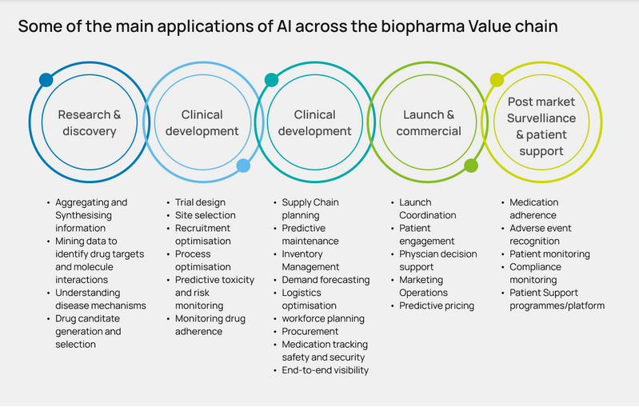

Slide 13
Future directions:
Artificial intelligence (AI) is playing an increasingly important role in biotechnology, with the potential to revolutionize the field in the coming years. Here are some of the future directions in AI in biotechnology:
Drug discovery: AI algorithms can analyze large amounts of data to identify new drug targets, design new molecules, and predict their efficacy and safety. This can help accelerate the drug discovery process and reduce the costs and risks of developing new drugs.
Precision medicine: AI can help personalize treatment plans for individual patients by analyzing their genetic and clinical data. This can improve the efficacy of treatments and reduce the risk of adverse events.
Bio processing: AI can optimize bio processing operations by analyzing data from sensors, monitoring equipment, and other sources. This can help improve product quality, reduce waste, and increase efficiency.
Bioinformatics: AI can help analyze large-scale genomic, proteomic, and metabolomic data to identify patterns and relationships that are difficult for humans to detect. This can lead to new insights into the underlying biology of diseases and help identify new targets for drug development.
Synthetic biology: AI can help design and engineer synthetic biological systems with specific functions, such as producing bio fuels, pharmaceuticals, or industrial chemicals. This can help improve the efficiency and sustainability of industrial processes.

Slide 14
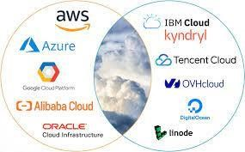
Some of the companys that uses AI

Slide 15
Methodology
The development of artificial intelligence to run a biotech business was made by a few organizations. Their management acquires the key as quickly as time-consuming strategies such as measuring old-fashioned testing or hand-crafted image inspection are as low as possible 1. The traditional methods of investigating information in a sad discovery work best with specific, identical information. However, such therapies miss the point when information is confusing, for example, when a patient writes down the findings, sales items, complex treatment plans, and more information about institutions and nurses. Let's see how Artificial Intelligence affects these branches of biotechnology. AI in Agricultural biotechnology Agricultural biotechnology develops genetically modified plants to increase crop yields or introduce new features to existing plants. It includes conventional plant breeding, tissue culture, micro propagation, molecular reproduction, and genetic engineering. Biotechnology firms now use sophisticated manufacturing technology and machine learning techniques to develop and configure autonomous robots that handle important agricultural activities such as harvesting crops faster than humans. Computer Vision and Deep Learning algorithms are used to process and analyze data captured by drones. This helps to monitor plant and soil health. Machine learning algorithms help to track and predict various environmental changes such as climate change affecting crop yields.

Slide 16
MODELLING ANALYSIS
The KEY AI trends that will transform the biotechnology industry: 1. Boosting Innovations: From Lab to Market: The past decade has witnessed the requirement for fast-tracked innovation, production and preparation of medication, industrial chemicals, food-grade chemicals, and alternative biochemistry-related staple. AI in Biotech plays a vital role in boosting innovation not solely within The laboratories however additionally throughout the lifecycle of a drug or compound (right to the purpose wherever it reaches the market). Supported the target market, AI-based tools and applications facilitate in developing the structure of molecules. Machine learning, a set of AI, helps in hard permutations and mixtures of varied chemicals to grasp the proper combination, while not having to perform the experiments within the science lab through manual processes. The utilization of AI in biotechnology is delivery innovations which will facilitate in prophetic analysis to forecast the demand for a selected drug or a chemical within the market

Slide 17
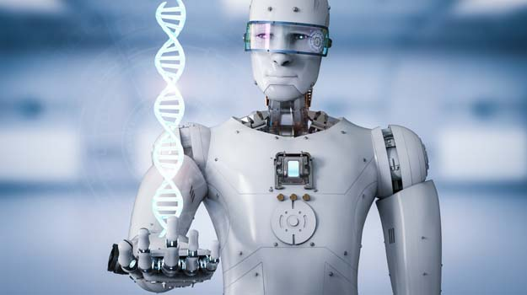
AI ethics, fairness and trust
Can we trust an AI in crucial fields such as biotechnology ?

Slide 18
AI ethics, fairness and trust
Finally, there is no question that AI ethics, fairness and trust are very important research topics in the application of AI for biotechnology. Some examples of (open) research questions include:
How can we ensure that AI systems are designed and used in ways that are ethically and socially responsible, and that respect fundamental human rights and values?
How can we ensure that AI systems are fair, and do not perpetuate or amplify existing biases or discrimination?
How can we ensure that AI systems are transparent and explainable, so that they can be trusted by users and stakeholders?
How can we ensure that AI systems are secure, and do not expose individuals or organizations to risks or harms?
How can we ensure that the development and deployment of AI systems is inclusive and involves diverse perspectives and voices?
How can we address the ethical and societal implications of emerging technologies such as artificial general intelligence, machine learning, and autonomous systems?
How can we develop and implement effective policies, regulations, and governance frameworks for AI?
How can we foster dialogue and collaboration between researchers, policymakers, industry, civil society, and other stakeholders to address the ethical and societal implications of AI?
How can we educate and raise awareness about AI ethics, fairness, and trust among the general public, as well as among those who design, develop, and use AI systems?

Slide 19
CONCLUSION
AI is increasingly used in Biotechnology, although to a lesser degree than technology overall. – In 2020, about 17.5 percent of all public patent applications included AI, while about 3.5 percent of Biotech applications did. • Biotechnology AI patenting is diffusing across technologies, owners, and inventor-patentees. – In 2020, 17.5 percent of biotech patent technology sub-classes contained AI. – About 10 percent of Biotech patent owners-at-grant and about 5 percent of Biotech inventor-patentees patented in AI in 2020. • Allowance rates for AI in Biotechnology have trended similarly to all AI applications in recent years, and AI Biotech allowance rates are slightly lower than non-AI Biotech allowance rates.

Slide 20
CODE DEMONSTRATION
As an AI language model, I can provide you with a general template of how AI can be used in biotechnology, but I cannot write C++ code. However, I can provide you with some pseudo code that can help you understand how to use AI in biotechnology. One area where AI is making an impact in biotechnology is in drug discovery. Here is an example of how AI can be used to predict the activity of a drug molecule:

Slide 21
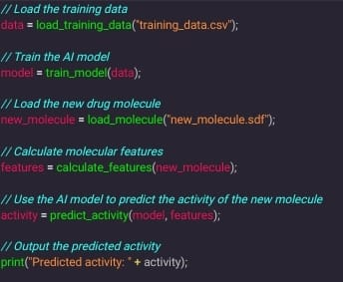
Code Section

